Slide 1

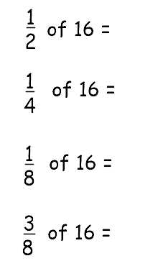
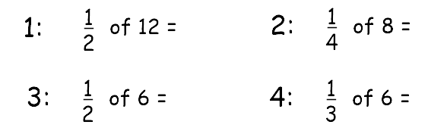

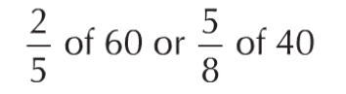
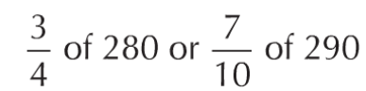
Keywords
EQ: How do I find the percentage of an amount without a calculator?
Sunday, 28 March 2021
Percentage
Fraction
Equivalent
Finding a percentage of an amount.
Convert
Equal
Decimal
8
STARTER
6
2
4
2
3
2
6
24
25
Which is larger?
210
203

Slide 2
Contents
Glossary or Formula Page
Page
Date
Essential Question
24
7
30
Word or Formula
Definition or Example

Slide 3
Tasks
24
7
30
Topic
Essential Question
Questions
Notes
Summary
1
2

Slide 4
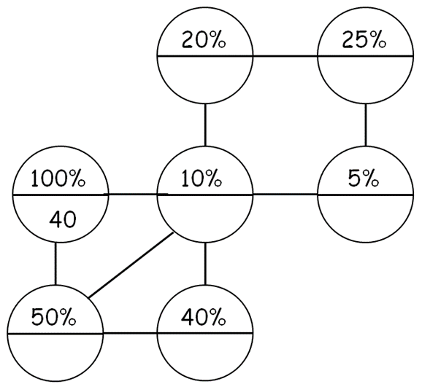
EQ: How do I find the percentage of an amount without a calculator?
Percentage of an amount
Firstly lets have a think about each of the relationships between each bubble
This is a percentage bubble, we can find out a percentage of any amount by using this.
Double it
÷ 10
Half it
Half it
÷ 10
1%
Half it
25%

Slide 5

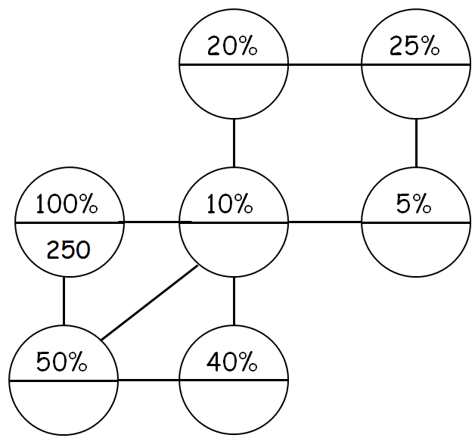
EQ: How do I find the percentage of an amount without a calculator?
Hinge questions

Slide 6
EQ: How do I find the percentage of an amount without a calculator?
Fluency and Understanding
Questions
What is 30% of 50?
What is 45% of 50?
What is 75% of 50?
What is 95% of 50?
Bonus Questions
What is 80% of 250?
What is 35% of 250?
What is 90% of 250?
What is 1% of 250?
Star Questions:
Can you calculate 11% of 250?
Can you calculate 26% of 50?
Choose a tricky percentage of an amount to calculate and show your teacher how it’s done!

Slide 7

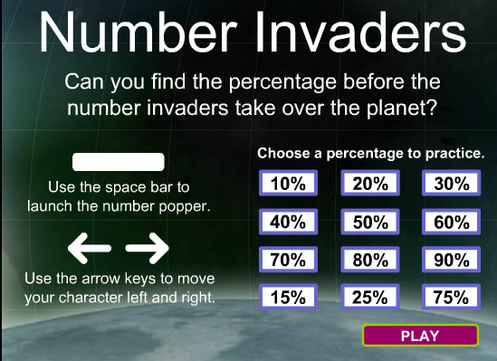
EQ: How do I find the percentage of an amount without a calculator?
Fluency and Understanding
https://play.kahoot.it/#/k/6abe7746-72e7-4a2c-9e43-49231dbf8fcf
https://play.kahoot.it/#/k/d52a93e9-b7cb-448a-ac15-a8ec3d745b4c
http://www.mathplayground.com/balloon_invaders_percent.html
Save one for next lesson

Slide 8





EQ: How do I find the percentage of an amount without a calculator?
Plenary
What have you learnt?
Draw your brain
How do we feel we are doing??
Where are we in our journey?

Slide 9


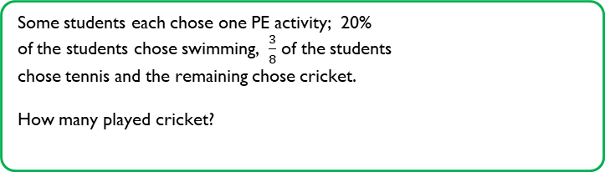



EQ: How do I find the percentage of an amount without a calculator?
Percentages
Learning Outcomes:
Compare two quantities using percentages
Keywords:
Decimals
Percent (%)
Fractions
Percentage
STARTER
20% $of £60$
75 % $of £1000$
80% $of £70$
20% of $35
25% of €5
65% of £3.50
Some students each chose one PE activity; 20%
of the students chose swimming, $\frac{3}{8}$ of the students
chose tennis and the remaining chose cricket.
How many played cricket?
Notes:
Quick starter ans. A. 12 b. 750 c. 216 d. 7 e. 1.24 f. 2.275.
Encourage discussion in the depth questions.

Slide 10

EQ: How do I find the percentage of an amount without a calculator?
Alternative method
Fluency and Understanding
10%
÷10
÷100
1%
EXAMPLES
(a)
10% of $40
(b)
10% of $180
(c)
10% of $57
(d)
10% of $472
=
$4
=
£18
=
£5.70
=
£47.20
(e)
20% of 50m
(f)
20% of 190km
(g)
30% of 40cm
(h)
30% of 90mm
10% = 5m
10% = 19km
10% = 9mm
x2
x2
x2
x2
10% = 4cm
x3
30% =
x3
20% =
20% =
x3
x3
27mm
10m
38km
30% =
12cm
(i)
(j)
(k)
80% of 20days
(l)
40% of 80min
60% of 70hours
90% of 30years
10% = 8min
10% = 7hours
10% = 3years
x4
x4
x6
x6
10% = 2days
x9
x9
90% =
40% =
60% =
x8
x8
27years
32min
42hours
16days
80% =
(m)
5% of 60oz
(n)
5% of 90ml
(o)
35% of 80cl
(p)
17.5% of 60litres
10% = 6oz
10% = 9ml
10% = 8cl
10% = 6litres
÷2
x3
x3
÷2
÷2
5% =
÷2
30% =
÷2
÷2
5% =
24cl
5% =
3oz
4.5ml
3litres
5% =
4cl
÷2
2.5% =
1.5litres
÷2
28cl
35% =
17.5% =
10.5litres

Slide 11
EQ: How do I find the percentage of an amount without a calculator?
Hinge
Find:
20% of 60
6
8
A)
B)
12
20
C)
D)

Slide 12
EQ: How do I find the percentage of an amount without a calculator?
Hinge
Find:
5% of 80
0.8
8
A)
B)
10
4
C)
D)

Slide 13
EQ: How do I find the percentage of an amount without a calculator?
Hinge
Find:
15% of 40
16
6
A)
B)
8
4
C)
D)

Slide 14
EQ: How do I find the percentage of an amount without a calculator?
Hinge
Find:
15% of 40
16
6
A)
B)
8
4
C)
D)

Slide 15
EQ: How do I find the percentage of an amount without a calculator?
Hinge
Find:
35% of 120
52
40
A)
B)
36
42
C)
D)

Slide 16
EQ: How do I find the percentage of an amount without a calculator?
Hinge
Find:
55% of 140
70
77
A)
B)
110
64
C)
D)

Slide 17
EQ: How do I find the percentage of an amount without a calculator?
Hinge
Find:
75% of 180
160
135
A)
B)
150
90
C)
D)

Slide 18
EQ: How do I find the percentage of an amount without a calculator?
Hinge
Find:
17.5% of 40
7
8
A)
B)
7.5
6
C)
D)

Slide 19
L
EQ: How do I find the percentage of an amount without a calculator?
Fluency and Understanding
TASK 1
TASK 2
TASK 3
10% of £80 =
10% of £130 =
10% of £459 =
10% of £36 =
20% of £60 =
20% of £140 =
20% of £62 =
30% of £70 =
30% of £180 =
30% of £120 =
40% of £80 =
40% of £240 =
40% of £360 =
50% of £160 =
50% of £380 =
50% of £131 =
60% of £90 =
60% of £110 =
70% of £30 =
70% of £410 =
80% of £40 =
80% of £120 =
90% of £120 =
90% of £800 =
5% of £360 =
5% of £1480 =
15% of £180 =
15% of £400 =
25% of £180 =
25% of £420 =
35% of £60 =
35% of £80 =
45% of £90 =
65% of £40 =
75% of £60 =
95% of £10 =
£8
£80
£27
£13
£190
£60
£45.90
£65.50
£45
£3.60
£54
£105
£12
£66
£21
£28
£21
£28
£12.40
£287
£40.50
£21
£32
£26
£54
£96
£45
£36
£108
£9.50
£32
£720
£96
£18
£144
£74

Slide 20
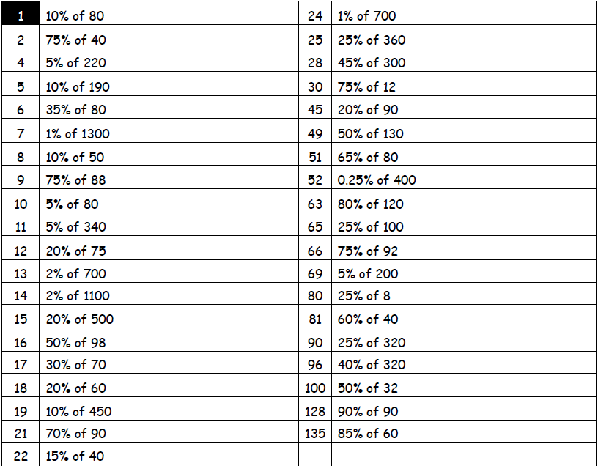

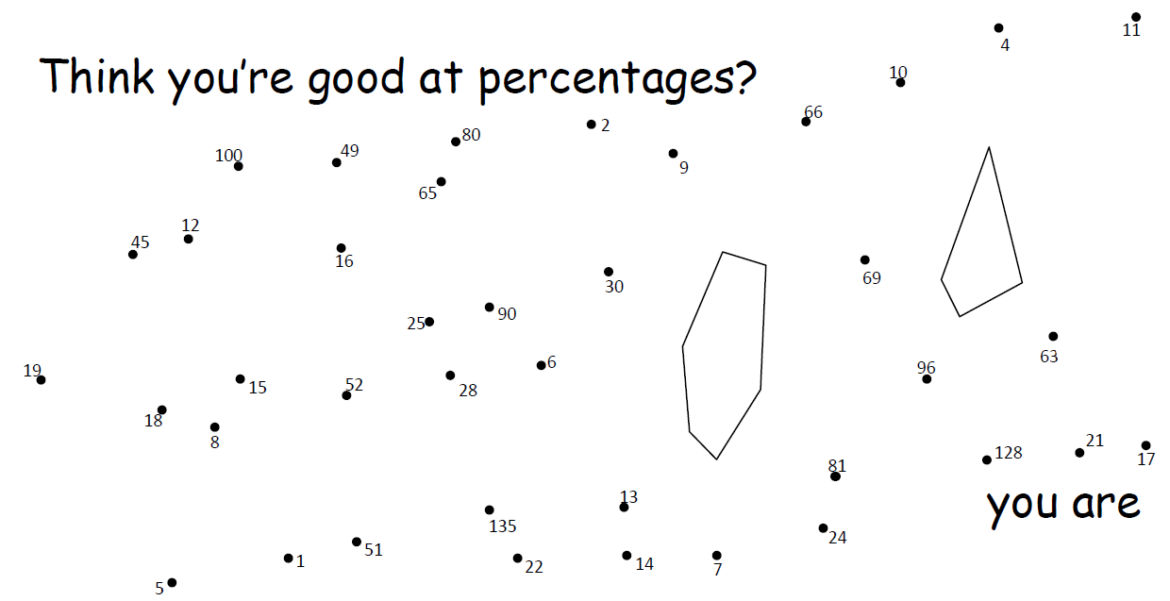
L
EQ: How do I find the percentage of an amount without a calculator?
Fluency and Understanding
= 8
= 7
Join the question number to its answer
= 30
= 90
= 11
= 135
= 19
= 9
= 28
= 18
= 13
= 65
= 5
= 52
= 66
= 1
= 4
= 96
= 17
= 25
= 15
= 69
= 14
= 22
= 10
= 100
= 2
= 49
= 24
= 21
= 80
= 12
= 128
= 45
= 16
= 63
= 81
= 6
= 51

Slide 21
H
EQ: How do I find the percentage of an amount without a calculator?
Fluency and Understanding
TASK 1
TASK 2
15% of £180 =
15% of £400 =
25% of £180 =
25% of £420 =
35% of £60 =
35% of £80 =
45% of £90 =
65% of £40 =
75% of £60 =
95% of £10 =
£27
28% of £200 =
63% of £500 =
19% of £400 =
37% of £80 =
82% of £54 =
51% of £40 =
4% of £90 =
23% of £6 =
15.5% of £420 =
17.5% of £390 =
£56
£60
£315
£45
£76
£105
£29.60
£21
£44.28
£28
£20.40
£40.50
£3.60
£26
£1.38
£45
£65.10
£9.50
£68.25

Slide 22
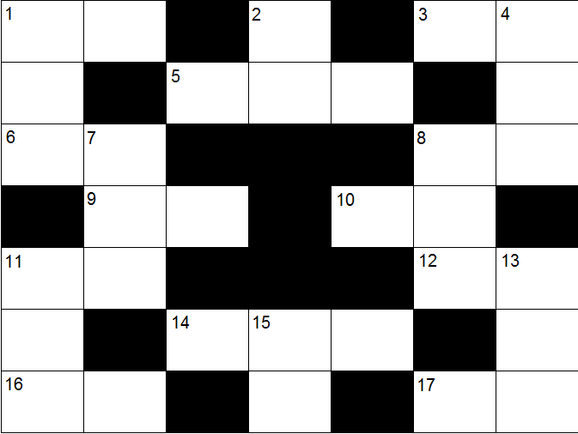
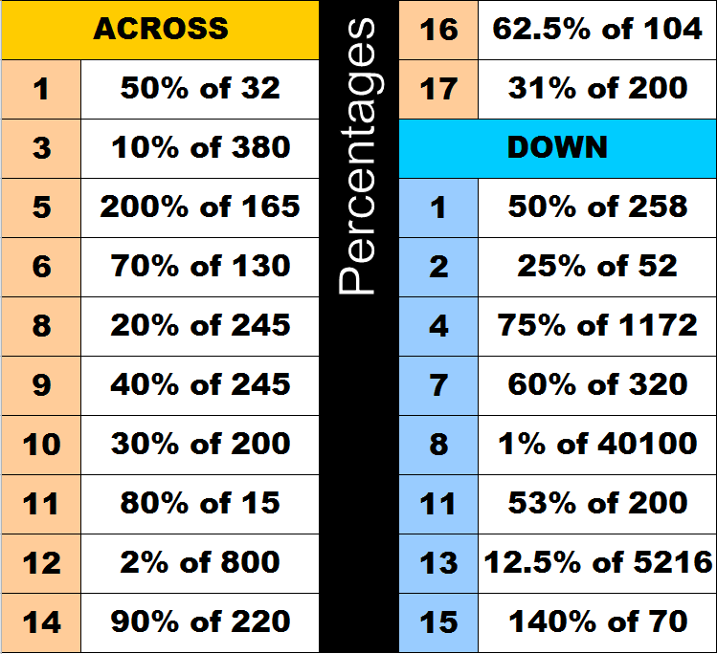
H
EQ: How do I find the percentage of an amount without a calculator?
Fluency and Understanding
1
6
1
3
8
2
3
3
0
7
9
1
4
9
9
8
6
0
1
2
1
6
0
1
9
8
5
6
5
8
6
2

Slide 23
EQ: How do I find the percentage of an amount without a calculator?
Fluency and Understanding
https://play.kahoot.it/#/k/6abe7746-72e7-4a2c-9e43-49231dbf8fcf
https://play.kahoot.it/#/k/d52a93e9-b7cb-448a-ac15-a8ec3d745b4c
http://www.mathplayground.com/balloon_invaders_percent.html

Slide 24
EQ: How do I find the percentage of an amount without a calculator?
Which is the biggest?
25% of 200
30% of 150
12% of 400
10% of 480
50% of 94
24.5% of 200

Slide 25
EQ: How do I find the percentage of an amount without a calculator?
Problem Solving Task
There are 800 students at Millwall Mathematics College.
22% of these 800 students are in Year 9.
There are 180 students in Year 10.
Which Year Group is the largest?
95 of the students were absent from school on Wednesday.
Trudy says that more than 12% of the 800 students were absent on Wednesday. Is she correct? Explain your answer.
Notes:
Task slide:
Students can work on these questions individually

Slide 26

EQ: How do I find the percentage of an amount without a calculator?
Extended Abstract and Depth
Edgar and Billy are calling their customers. Edgar has called 4% of his customers. Billy has called 4 out of 95 of his customers. Who has called a greater percentage of his customers?
Last year, Joseph picked 46 out of 82 tomatoes in his garden.
Wesley picked 58% of the tomatoes in his garden.
Who picked a greater percentage of his tomatoes?
Notes:
Task slide:
This task can be used to help the student think deeper about the topic. Should work best as a extension task.

Slide 27
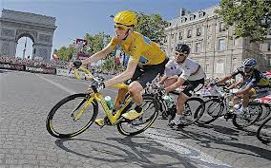
EQ: How do I find the percentage of an amount without a calculator?
Extended Abstract and Depth
A class of sixty voted for class president. 30% voted for Brad and 70% voted for Jane. How many more votes did the winner get?
A photograph is reduced to 75% of its original size. The photo was originally 12 inches by 16 inches. What are the new dimensions after it has been reduced? What is the percentage reduction in the overall area?
In a poll, 39 out of 80 students surveyed at Grant College said they travelled by bike, whereas 49% of the students polled at Polk University said they travelled by bike. Which college has a greater percentage of students who travel by bike?
Notes:
Task slide:
This task can be used to help the student think deeper about the topic. Should work best as a extension task.

Slide 28
EQ: How do I find the percentage of an amount without a calculator?
Find the Odd One Out
25% of 300
50% 0f 150
10 % of 750
1% of 8000

Slide 29
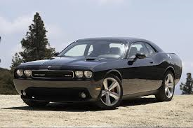
EQ: How do I find the percentage of an amount without a calculator?
Plenary Thinking Question
Ibz says that Mike owes him 12.5% of 4200. Mike gives Ibz $30 to settle the debt.
Should Mike have done that?
Dave buys a car for $16000. He can either have 15% off or $2500 discount.
Which is the best deal?

Slide 30
EQ: How do I find the percentage of an amount without a calculator?
Plenary
200 pupils enter a drawing competition. 44% of them are girls.
  How many more boys than girls are there?
A jogging route is 20km long. Lee Ming has jogged 30% of the route and James has jogged 45%. How much further is James ahead?
EXTENSION
Valerie had 20% fewer marbles than Yana. When Yana gave Valerie 20 marbles they both had the same number of marbles each.
How many marbles were they sharing in total?
Notes:
Teaching slide:

